Slide 1


InterNexus
A Strategic National Russell Group-Style Research Collaboration Group

Slide 2
Introduction & Overview
InterNexus
Open innovation hub
Leveraging Malaysia's R&D strength

Slide 3
Vision & Concept
Unique concept
Collaboratory model
Innovation-focused

Slide 4
Technical Execution & Progress
Prototype development
User experience
Ongoing development

Slide 5
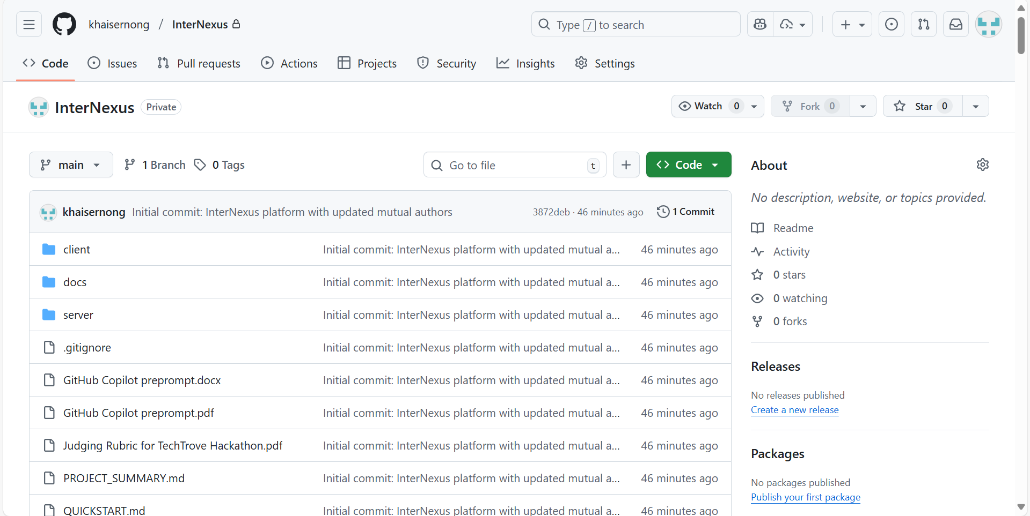

Slide 6
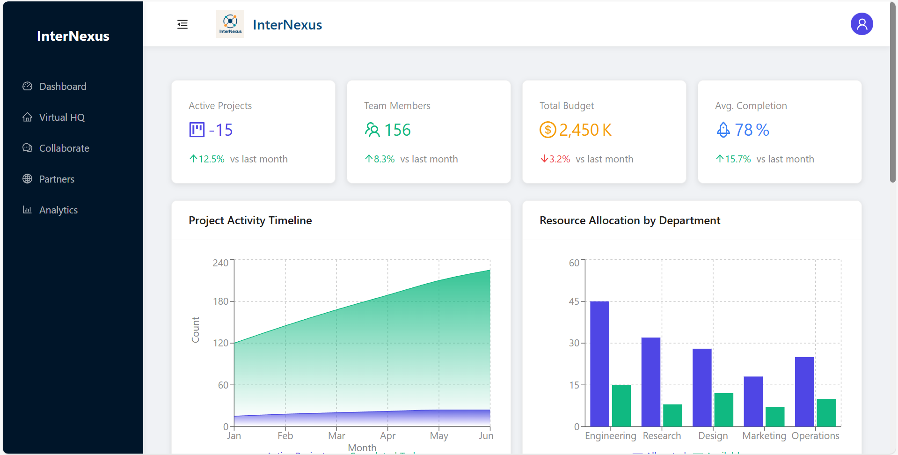

Slide 7
Feasibility & Future Potential
Strong foundation
Scalable roadmap
Economic & societal impact
Sustainability

Slide 8
Strategic Partnerships & Open Innovation
Cross-sector nexus
Global linkages
Open innovation platform
Academic-industry synergy

Slide 9
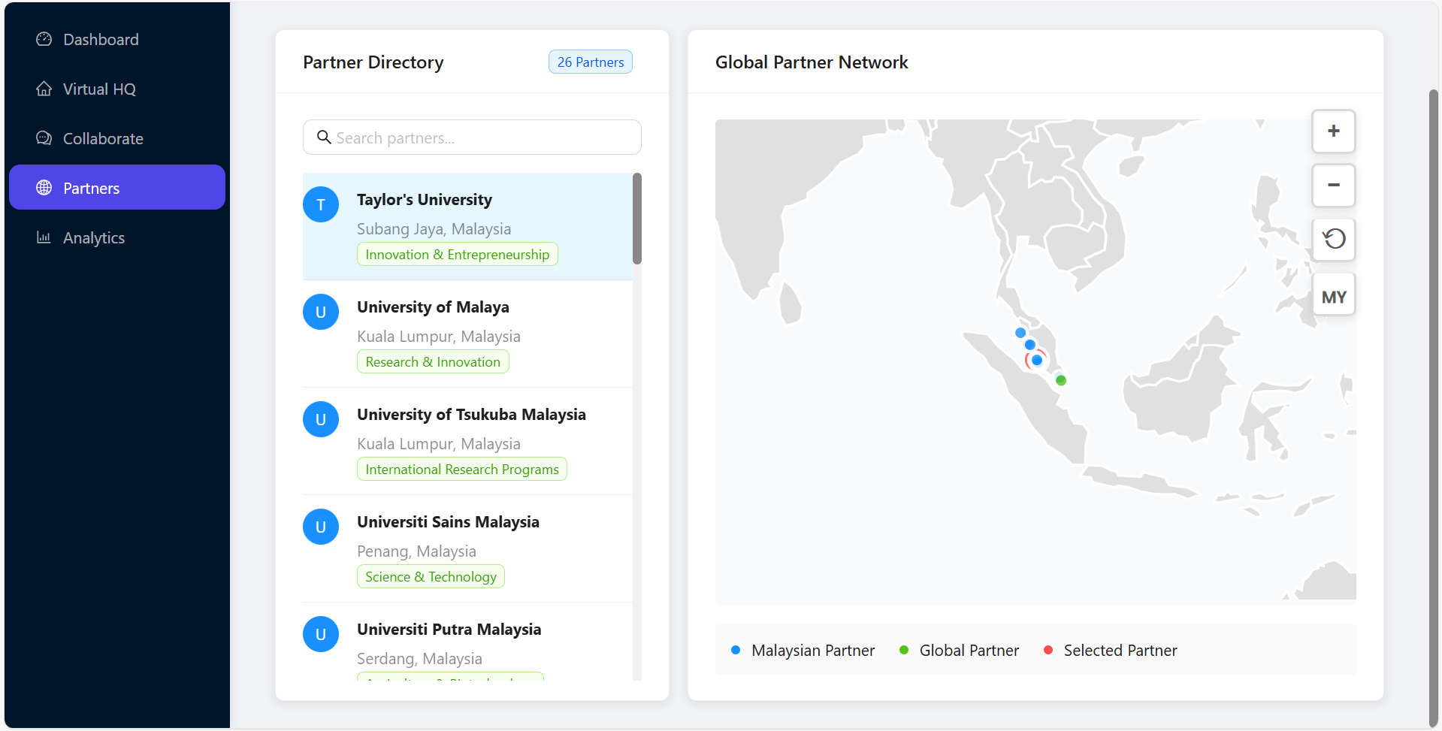

Slide 10
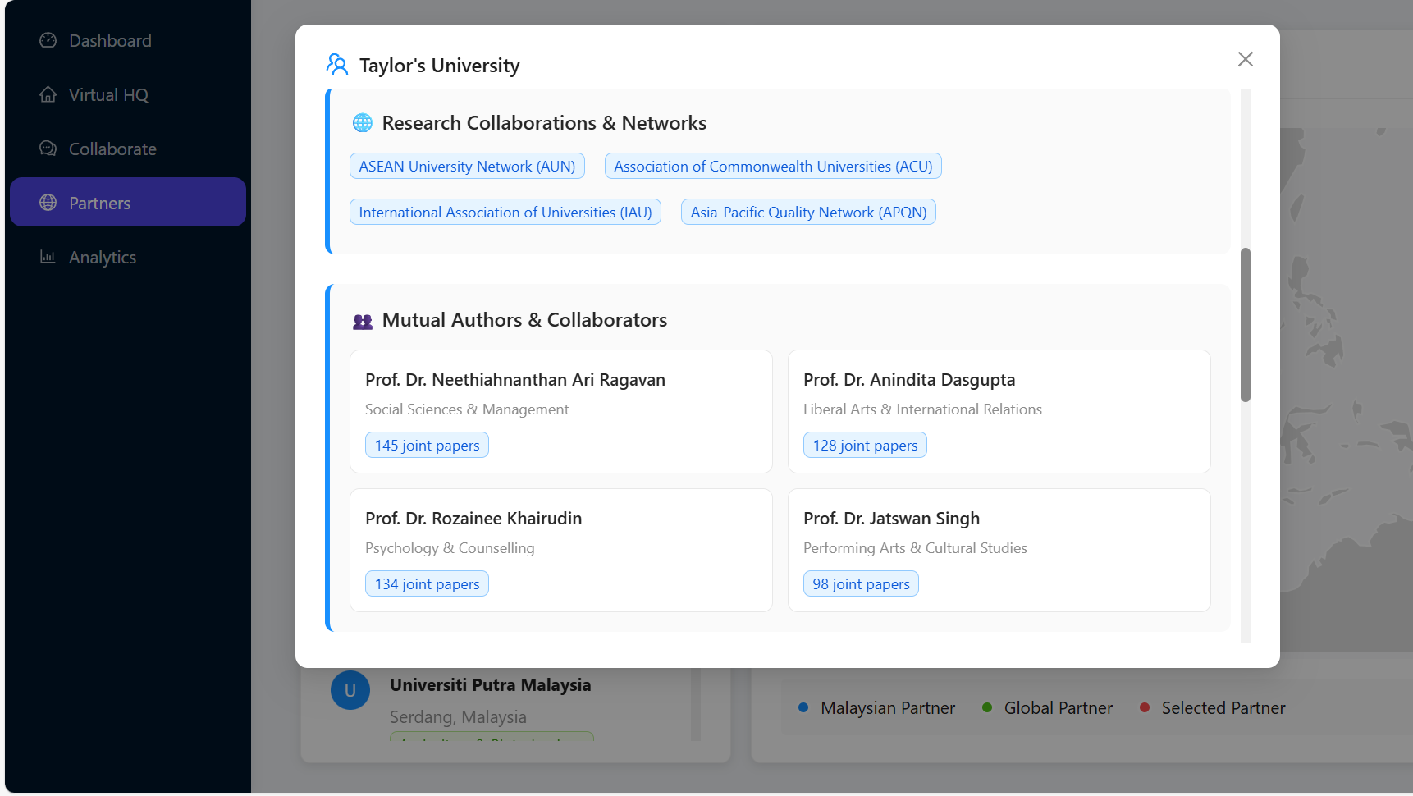

Slide 11
Conclusion & Call to Action
Aligned with national vision
Forward-looking impact
Invitation to collaborate

Slide 12
Q&A – Anticipated Questions
How will InterNexus secure long-term funding and governance?
What outcomes or metrics will define success?
How will we facilitate effective collaboration among very different partners?
What is the implementation timeline and next phases after the hackathon?

